Slide 1

Security Assessment
[T.Harsha Vardhan]
[CBS-0202]

Slide 2
Project Scenario

Slide 3
Overview
As the lead security engineer for CryptoV4ult, a prominent international cryptocurrency platform, you're tasked with ensuring the security and integrity of our newly established infrastructure. With over 1 million users relying on our services, it's imperative that we maintain the highest standards of security to protect their digital assets.
Your role involves a comprehensive review of the security landscape for our new application technology stack, identifying potential vulnerabilities, and running scans to assess any existing threats. Your scope encompasses various entities within our architecture, including the application itself, containerized services, and the external-facing API.
Ultimately, your objective is to develop a robust remediation plan that not only addresses current vulnerabilities but also strengthens our overall security posture, safeguarding both user data and the platform's reputation. This critical mission presents an exciting opportunity to leverage your skills and expertise in cybersecurity to fortify our infrastructure and uphold our commitment to providing a secure and reliable platform for our users. Let's embark on this journey together to ensure CryptoV4ult remains a trusted leader in the cryptocurrency industry!

Slide 4
Section 1:
Integrating SDLC (20)

Slide 5
Transitioning to Secure SDLC
As the lead security engineer at CryptoV4ult, you are tasked with ensuring the new infrastructure is developed securely. Your responsibility is to reorganize the existing development tasks to fit into a Secure Software Development Lifecycle (SDLC) framework, ensuring that each stage of the lifecycle incorporates necessary security tasks to protect user data and maintain the integrity of the cryptocurrency platform.

Slide 6
Transitioning to Secure SDLC
Place every task into a Secure SDLC category in the next few slides. Add at least one additional task to each phase that helps enhance security.
Conduct user interviews to gather functional requirements.
Write a requirements document for task management features.
Create a high-level architecture diagram for the application.
Design the database schema for tasks.
Code the user interface using HTML and CSS.
Implement interactive elements using JavaScript.
Set up a Flask application to handle API requests.
Implement CRUD operations for tasks.
Write and execute functional test cases.
Conduct browser compatibility testing.
Deploy the application to Heroku.
Perform smoke testing on the deployed application.
Monitor application logs and fix reported issues.
Gather user feedback for future feature additions.

Slide 7
Transitioning to Secure SDLC
Requirements Analysis
1. Conduct user interviews to gather functional requirements. 2. Write a requirements document for task management features. Additional Task : 1.Identifying potential threats based on designed architecture ,risk assessments and workflows.
Design
3. Create a high-level architecture diagram for the application. 4. Design the database schema for tasks. Additional Task : 1. Conducting a secure design review, including dataflow and attack surface analysis to minimize vulnerabilities at the design level. And designing with assuming everything could be compromised.

Slide 8
Transitioning to Secure SDLC
Development
5. Code the user interface using HTML and CSS. 6. Implement interactive elements using javascript. 7. Set up a Flask application to handle API requests. 8. Implement CRUD operations for tasks. Additional Task : 1. Secure coding practices like input validation, output encoding, and protect from injections and xss cross scriptings.
Testing
9. Write and execute functional test cases. 10.Conduct browser compatibility testing. Additional Task : 1. Perform static and dynamic scans to find vulnerabilities and perform different scans using owsap and burpsuite to find vulnerabilities.

Slide 9
Transitioning to Secure SDLC
Deployment
11. Deploy the application to heroku. 12. Perform smoke testing on the deployed application. Additional Task : 1. Conduct vulnerability assessment and penetrartion testing (vapt) before going live and ensure secure configuration.
Maintenance
13. Monitor application logs and fix reported issues. 14. Gather user feedback for future additions. Additional Task : 1. Set up real-time security monitoring for real-time alerts and do regular security patches.

Slide 10
Advocating for Secure SDLC
As the lead security engineer at CryptoV4ult, you're spearheading the shift towards a more secure and agile development process. To get everyone on board, create a succinct list highlighting five essential advantages of transitioning to the Secure Software Development Lifecycle (SDLC) from our current Waterfall methodology. For each advantage, include a brief explanation that underscores its importance, particularly focusing on how it benefits the dynamic and security-centric nature of our cryptocurrency platform.

Slide 11
Advocating for Secure SDLC
1. Early Detection of vulnerabilities
Identfying security issues in the early phases reduces cost and impact of cyber attacks and breaches.
2. Better Risk Management
Secure SDLC conducts risk assessments at every phase . This helps to fix bugs and errors in every phase and maintains good security.
3. Flexibility and Scalability in Security
Security practices along with your architecture building and allows scalability and flexibility in project or application.
4. Reduced development and Fixing costs
Fixing vulnerabilities early is 5x cheaper then post-deployment fixes this saves more money and time and also saves from data breaches.
5. Faster Incident Response
Secure SDLC includes active monitoring and logging mechanisms this helps rapid response in case of attacks and breaches.

Slide 12
Section 2:
Vulnerabilities and Remediation (35)

Slide 13
Vulnerabilities and remediation
As CryptoV4ult enhances its infrastructure to support new features for its extensive user base, ensuring the security of user authentication mechanisms is paramount. The login system is critical to the platform's security, acting as the first line of defense against unauthorized access. Your task is to scrutinize a login system, identify 3 potential vulnerabilities they usually have, and propose effective remediation strategies.

Slide 14
Vulnerabilities and remediation
1. SQL INJECTION
Description
This happens when user inputs SQL queries directly to login page in the place of username and password without proper sanitization this allows attackers to manipulate and delete the database.
Risk
Bypass login by injecting ‘ OR ‘1’=‘1 in credentials. This extracts sensitive user data like usernames ,passwords ,payment information etc. Attacker can modify or delete data of the users. This will cause data breach.
Remediation
Validate and sanitize all user inputs. Don’t allow unformatted user inputs only allow alphanumeric and only some symbols. Regular scans with tools like burpsuite ,sqlmap etc.

Slide 15
Vulnerabilities and remediation
2. SESSION HIJACKING
Description
Attackers steal session tokens from cookies, URLs, allowing them to impersonate the victim without needing login credentials. Attacker captures the session id from insecure cookies and urls through different attacks.
Risk
It will give full account access to attacker allows to edit and delete data of the legitimate user. Finacial data will be leaked and it includes senstive data like bank information etc.
Remediation
Use https only and secure Flags. Regenerate session id’s on login and logout. Enable Multi-factor authentication.

Slide 16
Vulnerabilities and remediation
3. BRUTE FORCE ATTACKS
Description
Attackers systematically try many passwords cominations to guess user credentials like using possible no of passwords using social enginnering and dictionary attacks.
Risk
Can lead to account compromise especially if users use weak or common passwords. By these attackers can empty the legitemate users crypto wallets. If no 2fa then it is easy to compromise the device.
Remediation
Use rate limiting captchas after multiple failed attempts. Implement mfa and strong password polices. Implement Password complexity requirements in login pages.

Slide 17
Create a threat Matrix
Dissect and categorize the 3 vulnerabilities that you have identified for the login system. Understanding these vulnerabilities from a strategic viewpoint will enable the company to allocate resources efficiently, prioritize remediation efforts, and maintain CryptoV4ult's reputation as a secure and reliable platform.

Slide 18
Threat Matrix
Pathway (Vulnerability) | Impact Level | Likelihood Level
SQL INJECTION | High | High
SESSION HIJACKING | High | Medium
BRUTE FORCE ATTACKS | High | Medium
Fill out the matrix table. Impact levels are horizontal, and likelihood levels at the vertical axis.
Impact | Low | Medium | High
Likelihood
High |  | BRUTE FORCE | SQL INJECTION
Medium |  |  | SESSION HIJACKING
Low

Slide 19
Section 3:
Container Security (20)

Slide 20
Container Security
It is time to delve into the container services underpinning CryptoV4ult's application infrastructure by scanning for potential vulnerabilities. Scan one of the container services running in the application (located at vulnerables/cve-2014-6271) and identify potential vulnerabilities. Then, you will build a remediation plan to resolve some of the container vulnerabilities.

Slide 21
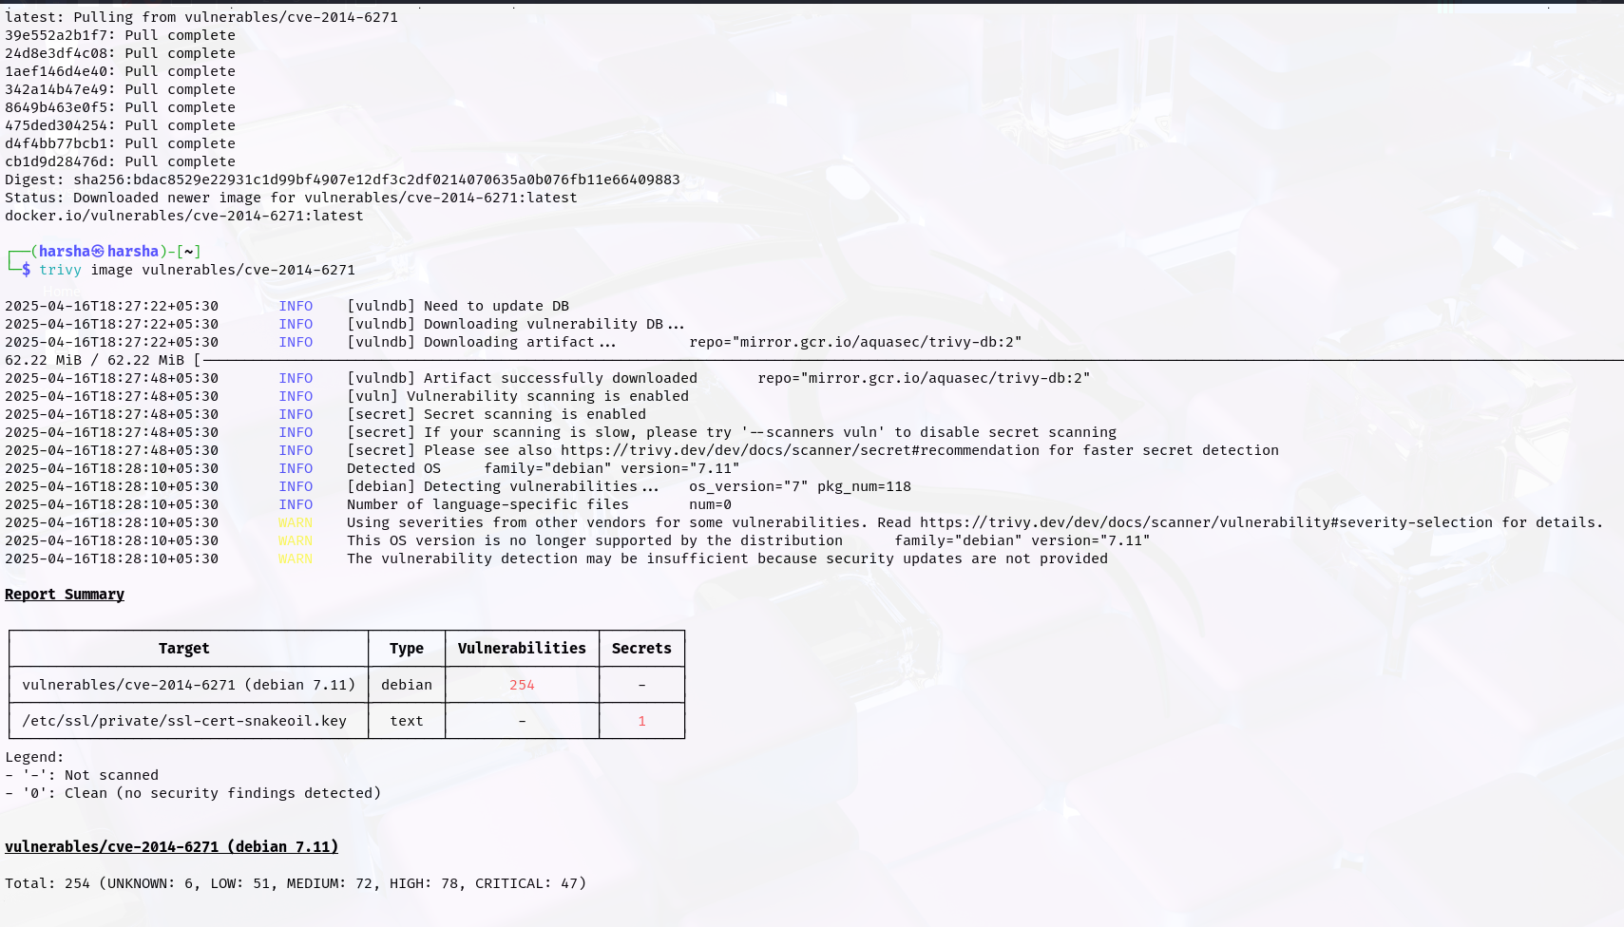
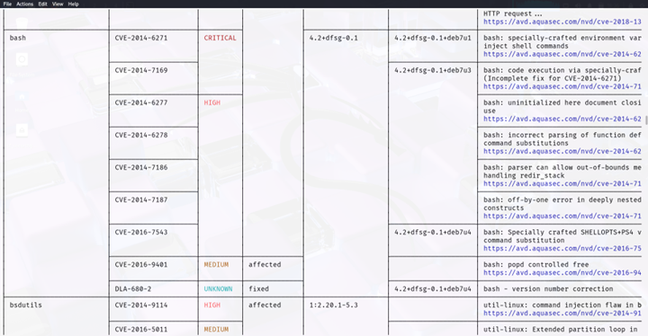
Trivy scan screenshot

Slide 22

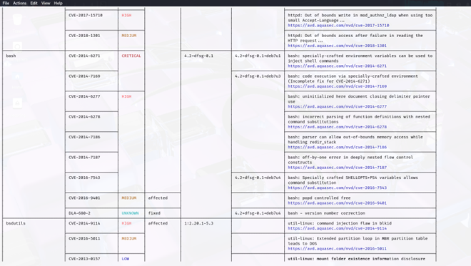
This Screenshot represents vulnerability scan results of container CVE 2014 – 6271 conducted using trivy .

Slide 23
Report to Fix Container Issues
Vulnerability Name | Unpatched Software Version | Patched Software Version
CVE-2014-6271 | 4.2+dfsg-0.1 | 4.2+dfsg-0.1+deb7u1
CVE-2014-7169 | 4.2+dfsg-0.1+deb7u1 | 4.2+dfsg-0.1+deb7u3
CVE-2014-6277 | - | -
CVE-2014-6278 | - | -
CVE-2014-7186 | - | -
CVE-2014-7187 | - | -
CVE-2016-7543 | 4.2+dfsg-0.1+deb7u3 | 4.2+dfsg-0.1+deb7u4

Slide 24
Section 4:
API Security (15)

Slide 25
API Security
Management has partnered with an external sales vendor and asked for a generic API to be developed that tracks user’s data. Based on the data ingested they will create targeted sales advertisements to the customer base, this means a lot of confidential info about the users will be shared to 3rd party vendors.
You need to identify 3 common API vulnerabilities and propose effective remediation strategies. Keep in mind this code does not exist; this is the initial stages of development, and you are providing guidance to the engineering team. Feel free to make any assumptions about API features, implementations, and what private data might be shared.

Slide 26
Vulnerabilities and remediation
1. Insecure Data Storage/Transmission
Description
Storing sensitive data like passwords, tokens etc in plaintext or sending sending data without encryption and using http instead of https.
Risk
Senstive data like login credentials or session tokens can be intercepted by attackers especially on public WI-FI or compromised networks.
Remediation
Implement HTTPS for all API communications. Redirect HTTP to HTTPS automatically.

Slide 27
Vulnerabilities and remediation
2. Lack of Rate Limiting
Description
Api’s doesn’t have limit how frequently a user or ip can make requests are vulnerable to brute force attacks.
Risk
Without rate limits users can try many password combinations. There is a Possibility of DDOS attack.
Remediation
Implement rate limiting per user or ip like certain no of requests per minute. If there are many requests from user’s ip then block the user request for some time.

Slide 28
Vulnerabilities and remediation
3. Broken object level authentication
Description
Api’s main vulnerability is it exposes endpoints like changing user ids at last and gains unauthorized access. Eg : user/1234 to user/1235.
Risk
It results in unauthorized access , identity theft , data modification etc. It cause data leak of senstive information of users.
Remediation
Always verify the user’s authorization for every data object they access. Implement object level authorization checks on every request.

